Slide 1
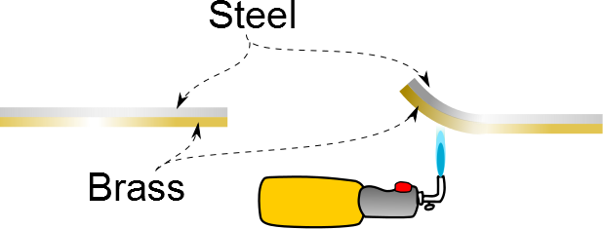

Slide 2
Material | Average α(K⁻¹)
Aluminum | 25×10⁻⁶
Copper | 17×10⁻⁶
Gold | 14×10⁻⁶
Lead | 29×10⁻⁶
Brass | 18.7×10⁻⁶
Steel | 11×10⁻⁶
Glass | 9×10⁻⁶
Concrete | 12×10⁻⁶

Slide 3
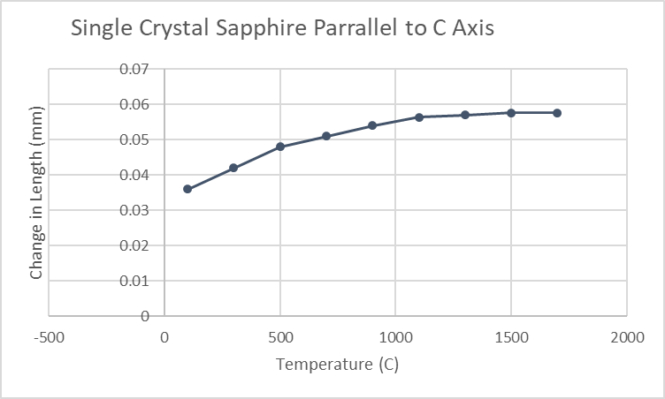

Slide 4
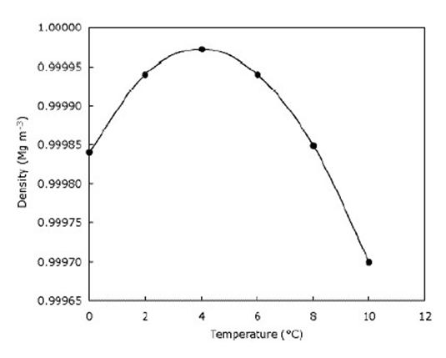

Slide 6

Vacuum
Membrane
Membrane
Gas at T_{i}
Gas at T_{i}

Slide 8
Question 123.9.4
Does the curve fit match the data?
Yes
No

Slide 9
Question 123.9.5
Does the curve fit match the data in the range
-6<x<5?
Yes
No

Slide 10
Question 123.9.6
Could the curve fit in the range
-6<x<5?
be useful?
Yes
No

Slide 12
Question123.9.7 Ideal Gas Law I
Two identical cylinders at the same temperature contain the same gas. If A contains three times as much gas as B, which cylinder has the higher pressure?
1) cylinder A
2) cylinder B
3) both the same
4) it depends on temp. T

Slide 13
Question123.9.5 Ideal Gas Law I
Two identical cylinders at the same temperature contain the same gas. If A contains three times as much gas as B, which cylinder has the higher pressure?
1) cylinder A
2) cylinder B
3) both the same
4) it depends on temp. T
Ideal gas law: PV = nRT
Solve for pressure: P = nRT / V
For constant V and T, the one with more gas (the larger value of n) has the higher pressure P.

Slide 14
Question123.9.8 Ideal Gas Law II
Two identical cylinders at the same pressure contain the same gas. If A contains three times as much gas as B, which cylinder has the higher temperature?
1) cylinder A
2) cylinder B
3) both the same
4) it depends on the pressure P

Slide 15
Question123.9.8 Ideal Gas Law II
Two identical cylinders at the same pressure contain the same gas. If A contains three times as much gas as B, which cylinder has the higher temperature?
1) cylinder A
2) cylinder B
3) both the same
4) it depends on the pressure P
Ideal gas law: PV = nRT
Solve for temperature: T = PV / nR
For constant V and P, the one with less gas (the smaller value of n) has the higher temperature T.

Slide 16
Question123.9.9 Ideal Gas Law III
Two identical cylinders at the same temperature contain the same gas. If B has twice the volume and half the number of moles as A, how does the pressure in B compare with the pressure in A?
1) P_{B} = 1/2 P_{A}
2) P_{B} = 2 P_{A}
3) P_{B} = 1/4 P_{A}
4) P_{B} = 4 P_{A}
4) P_{B} = P_{A}

Slide 17
Question123.9.9 Ideal Gas Law III
Two identical cylinders at the same temperature contain the same gas. If B has twice the volume and half the number of moles as A, how does the pressure in B compare with the pressure in A?
1) P_{B} = 1/2 P_{A}
2) P_{B} = 2 P_{A}
3) P_{B} = 1/4 P_{A}
4) P_{B} = 4 P_{A}
4) P_{B} = P_{A}
Ideal gas law: PV = nRT
Since B has a factor of two more volume, it has a factor of two less pressure. But B also has half the amount of gas, so that is another factor of two reduction in pressure. Thus, B must have only 1/4 the pressure of A.

Slide 18
Question123.9.10 Soda Bottle
A plastic soda bottle is empty and sits out in the sun, heating the air inside. Now you put the cap on tightly and put the bottle in the fridge. What happens to the bottle as it cools?
1) it expands and may burst
2) it does not change
3) it contracts and the sides collapse inward
4) it is too dark in the fridge to tell

Slide 19
Question123.9.10 Soda Bottle
A plastic soda bottle is empty and sits out in the sun, heating the air inside. Now you put the cap on tightly and put the bottle in the fridge. What happens to the bottle as it cools?
1) it expands and may burst
2) it does not change
3) it contracts and the sides collapse inward
4) it is too dark in the fridge to tell
The air inside the bottle is warm, due to heating by the sun. When the bottle is in the fridge, the air cools. As the temperature drops, the pressure in the bottle also drops. Eventually, the pressure inside is sufficiently lower than the pressure outside (atmosphere) to begin to collapse the bottle.

Slide 20
Question123.9.11 Balloon in Freezer
1) it increases
2) it does not change
3) it decreases
What happens to the volume of a balloon if you put it in the freezer?

Slide 21
Question123.9.11 Balloon in Freezer
1) it increases
2) it does not change
3) it decreases
What happens to the volume of a balloon if you put it in the freezer?
According to the Ideal Gas Law, when the temperature is reduced at constant pressure, the volume is reduced as well. The volume of the balloon therefore decreases.
PV
=
nRT
Follow-up: What happens to the volume
when the balloon rises in the air?

Slide 22
Question123.9.7
Your friend has shaken your soda can. The pressure inside has mostly
Increased
Decreased
Stayed the same
Can’t tell

Slide 23
Question 123.9.12
If we go from position A to position B in the PV diagram shown, along the red path, the temperature will
Increase
Decrease
Stay the same
Impossible to tell
B
A

Slide 24
Question 123.9.13
The process shown on this graph is called an
Isobaric process
Isochoric process
Adiabatic process
Isothermal process

Slide 25
Question 123.9.15
I have two pistons filled with gas. In which piston is the pressure higher?
290K
290K
A
B
C Both are the same
D Impossible to tell

Slide 26
Question 123.9.14
The process shown on this graph is called an
Isobaric process
Isochoric process
Adiabatic process
Isothermal process

Slide 27
Question 123.9.15
The process shown on this graph is called an
Isobaric process
Isochoric process
Adiabatic process
Isothermal process

Slide 33
F_{p,air}
F_{p,gas}
F_{g}

Slide 35
A

Slide 36
m

